Slide 1


BRITISH ENGLISH
VS.
AMERICAN ENGLISH

Slide 2
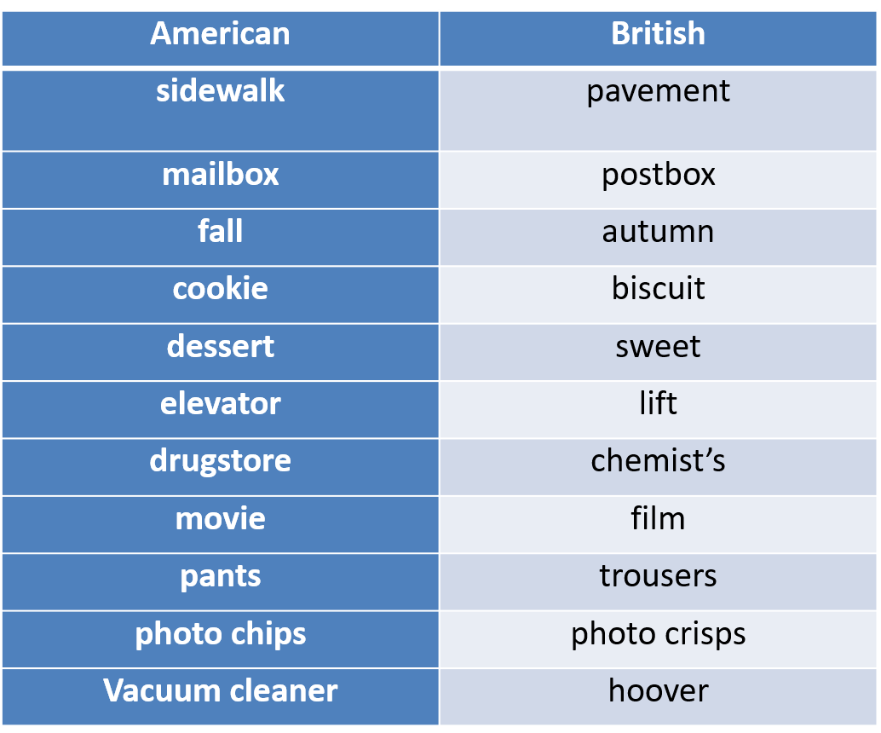
British English vs American English

Slide 3
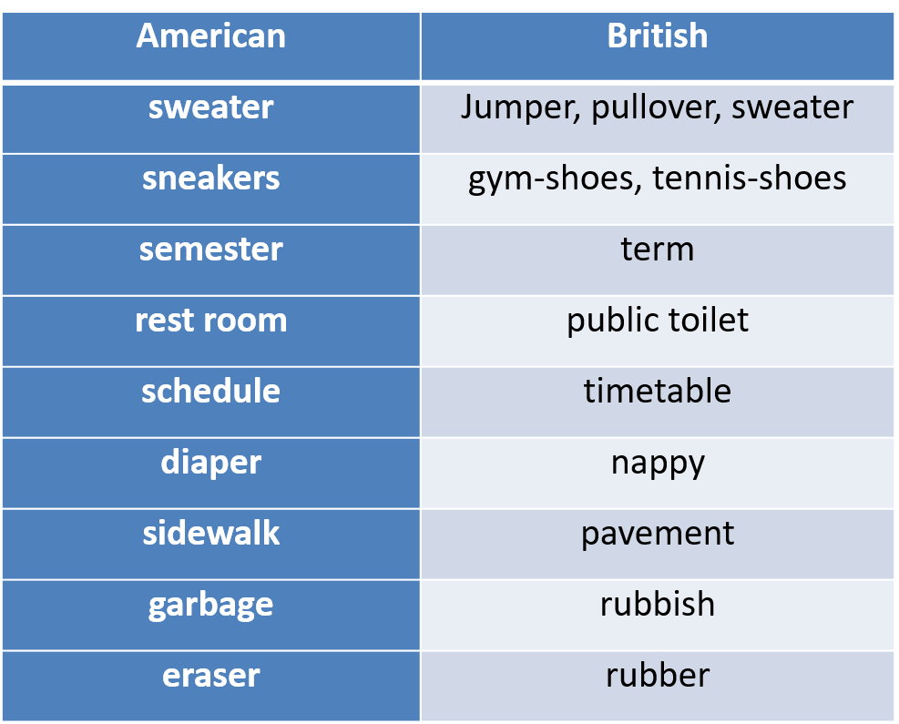
British English vs American English

Slide 4
Verb Phrase
AmE
I have an idea
I have two sisters.
Bill has to go.
Did you do your homework yet?
Do you have the time ?
I don´t.
I already ate.
BrE
I have got an idea
I’ve got two sisters.
Bill has got to go.
Have you done your homework yet?
Have you got the time ?
I haven´t.
I’ve already eaten

Slide 5
Conjugation
AmE : burn burned burned
BrE : burn burnt burnt
AmE : dream dreamed dreamed
BrE : dream dreamt dreamt
AmE : learn learned learned
BrE : learn learnt learnt

Slide 6
Adverbials and prepositions
AmE
I´ll go momentarily
real good
backward
It´s twenty of four
It´s in back of the
building
BrE
In a moment
really good
backwards
It´s twenty to four
It´s behind the building

Slide 7
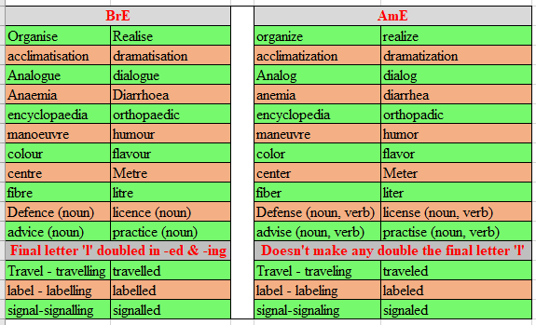
Spelling

Slide 8
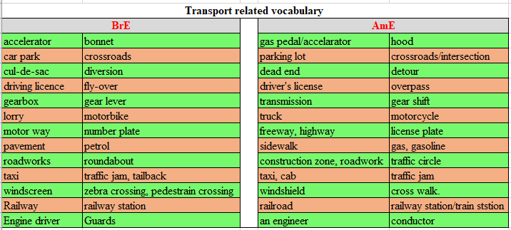
American and British Vocabs

Slide 9
American and British Vocabs
AmE
freedom fries
holiday
expressway
first floor
Subway
checking account
Caravan
airplane
baggage
cookie
BrE
chips
vacation
motorway
ground floor
underground
current account
Trailer
aeroplane
luggage
biscuit

Slide 10
Observe the language in BrE
Hi John,
How are you doing? What did you do on the weekend? What movies did you see recently? Did you buy a new cell phone already?
I have big news! My friend from Poland is coming on a visit this fall! I didn’t see him for 2 years already! I am waiting on him so much!
I had a lots of things to do last week. And not all of them were my favorites! My mum was mad with me all the time! Well, she asked me to go to the drug store to buy some diapers for my little brother and when I was walking down the sidewalk, I hit a trash can and my pants got dirty! I had to return home without diapers and my pants were covered with trash all over me! Can you imagine that! People on the street were laughing at me and I had to walk home as I couldn’t go by subway! I was really mad with myself!
Did I tell you that we are going to buy a new apartment? It’s so cool! The house has a huge elevator! There is a big shopping mall and a gas station nearby, and it’s almost in the center of the city, there are many theaters there as well!
I have to go now. See you soon!

Slide 11
Observe the language in BrE
Hi John,
How are you? What did you do at the weekend? What films have you seen recently? Have you bought a new cell phone yet?
I have big news! My friend from Poland is coming on a visit this autumn! I haven’t seen him for 2 years already! I am waiting for him so much!
I had a lot of things to do last week. And not all of them were my favourites! My mum was angry with me all the time! Well, she asked me to go to the chemist’s to buy some nappies for my little brother and when I was walking down the pavement, I hit a dustbin and my trousers got dirty! I had to return home without nappies and my trousers were covered with rubbish all over me! Can you imagine that! People in the street were laughing at me and I had to walk home as I couldn’t go by underground! I was really angry with myself!
Have I told you that we are going to buy a new flat? It’s so cool! The house has a huge lift! There is a big shopping centre and a petrol station nearby, and it’s almost in the centre of the city, there are many theatres there as well!
I have to go now. See you soon!

